Slide 1




Revolutionising patient care through automated appointment reminders

Slide 2
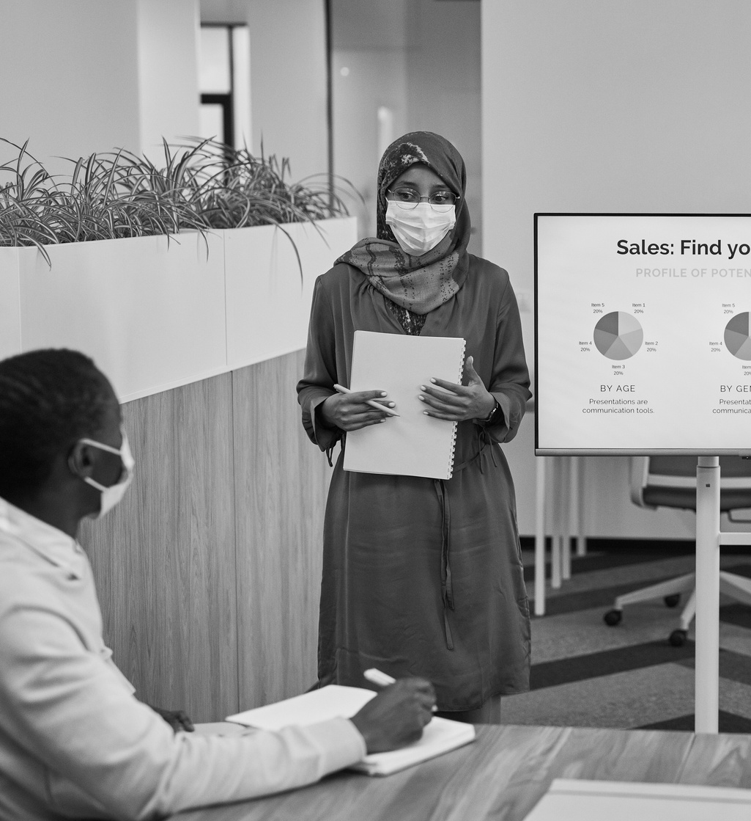
Problem Statement
Doctors and clinics often miss following up with patients due to manual systems.
Missed follow-ups can lead to worsening health outcomes and reduced patient trust.
There’s no affordable, easy-to-use system for small clinics to manage reminders efficiently.

Slide 3



Solution
A lightweight, affordable app that automates follow-up appointment reminders.
Sends SMS notifications to both patients and doctors on the scheduled date.
.
Integrated with Lovable and built using Python for reliability and ease of use

Slide 4
Product
Stores Patient Info: Contact details and appointment dates.
Sends Automated SMS Reminders: Triggers on appointment dates.
Scalable: Future expansion to WhatsApp, email, or app notifications.
Admin Panel: Easy management via Django Admin.

Slide 5

Statistics
01
2 out of 5 patients forget appointments when not reminded
02
95% of SMS messages are read within 3 minutes.
03
43 million people in Africa live in areas with limited digital health infrastructure.

Slide 6

Target Market
Private doctors – 20%
Local clinics – 20%
NGOs and health campaigns – 20%
Mobile health services – 20%
Pharmacies with consulting services – 20%

Slide 7

Market Size
Over 50,000 clinics and private practices across South Africa.
Market potential for reminder services: over R30M/year.

Slide 8

Competition
Doctrack,
Zocdoc
HealthEngine
All these are premium platforms

Slide 9

Competitive Advantage
Simpler, lightweight tool
Focused on follow-ups only
Works offline with SMS fallback
Low data usage and mobile-friendly
Built for low-bandwidth environments.
Focused only on follow-ups = easy to implement.
Open-source-ready; can be adopted by health NGOs.
Low cost and requires no new hardware.

Slide 10
Project Traction
Month 1:
🛠 Built MVP using Django and integrated database for appointments
Month 2:
📲 Connected Twilio for sending SMS reminders; tested locally
Month 3:
🧪 Ran a small pilot with a local clinic; sent real reminders
Month 4:
📢 Received positive feedback and interest from healthcare workers
Month 5:
📈 Preparing for public rollout, improved UI and planning onboarding strategy

Slide 11

Business Model
Freemium Tier: Free basic access for solo practitioners with limited SMS reminders.
Subscription Plans: Monthly paid plans for clinics and NGOs based on usage (e.g., R199–R799/month).
Pay-As-You-Go: On-demand SMS credits for flexible usage.

Slide 12
Business Model
Custom Deployments: Tailored solutions for large health organizations and government partners.
Revenue Streams: Subscriptions, SMS top-ups, custom setup fees, and long-term institutional contracts.

Slide 13

Go To Market
Partner with local health networks.
Direct outreach to private practices.
Social media campaigns targeting nurses/doctors.
Leverage NGO health partners.

Slide 14

Social Impact (SDG's)
Impilo Alert ensures patients receive timely follow-up care, improving treatment outcomes and reducing missed appointments.

Slide 15


Social Impact (SDG's)
The system leverages simple, scalable technology to enhance healthcare delivery in underserved communities.
By making follow-up care accessible even in low-resource settings, Impilo Alert helps bridge the healthcare gap for vulnerable populations.

Slide 16

Our Financial Ask
R100 000.00 seed funding
1. Technical Development – R30,000
• Django development, Twilio integration, frontend setup
2. Twilio SMS Credits – R15,000
• SMS reminders for pilot clinics and testing
3. Marketing & Outreach – R20,000
• Flyers, transport, ads, clinic demos

Slide 17
Our Financial Ask
4. Hosting & Tools – R10,000
• Cloud hosting, domain, email, repo tools
5. Team Support – R15,000
• Stipends for collaborators and testers
6. Buffer & Miscellaneous – R10,000
• Legal, internet, extra SMS volume

Slide 18
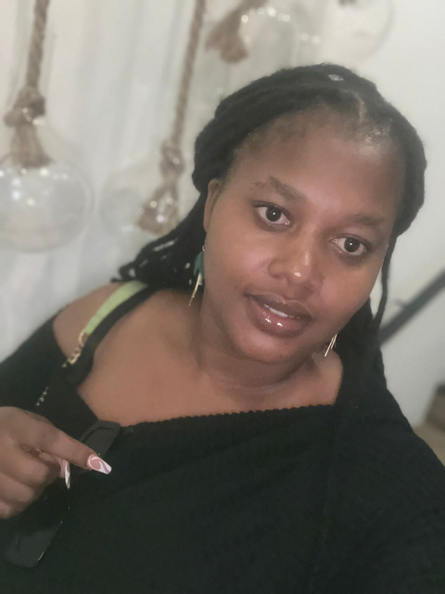

Our Team
Simamkele Sefalane
Founder/Developer
UX/UI tester
Mosa Mokhaneli
Founder/Developer
Research Assistant

Slide 19
Thank you!!
Simamkele Sefalane : kamogelesefalane@gmail.com
LinkedIn: www.linkedin.com/in/simamkele-sefalane-0aa6a715b
Mosa Mokhaneli: mosa.mokhaneli@gmail.com
LinkedIn: https://www.linkedin.com/in/mosa-dikeledi-mokhaneli-51b67669/

